Slide 1



OLIST STORE ANALYSIS
Domain : E-Commerce

Slide 2

Mr. Ghanshyam Ramdas Shinde
Mr. Abel Manoj Londhe.
Mr. Karthik Pallan
Mr.Nethen Peter
Mr. Shreyas Udaya Vernekar
Group 5 :

Slide 3






Project analysis slide 3
Contents
Introduction
Project Analysis
KPI
DASHBOARD
SWOT Analysis:
Strength
Weakness
Opportunities
Threat
Summary
KPIs
KPI (Key Performance Indicator). We Work on KPI’s.
Created dashboards using Business Intelligence tools Excel,PowerBI and Tableau.
Introduction of project.
With the help of analytics tools we analys the project.

Slide 4
INTRODUCTION :
Olist operates an online e-commerce site for sellers, that connects merchants and their products to the main marketplaces of Brazil.
Olist enables small merchants to gain market share across the country through its platform.
Olist is one of the Top largest departmental store inside Brazil’s largest marketplaces.
This project aims to analyze customer purchasing patterns and payment statistics on an e-commerce platform , Olist.

Slide 5
Project analysis slide 2
Project Analysis
DELIVERED STATUS
PAYMENT METHODS
PROJECT
PRODUCT CATEGORY
CUSTOMER DEMAND
REVIEW SCORES

Slide 6
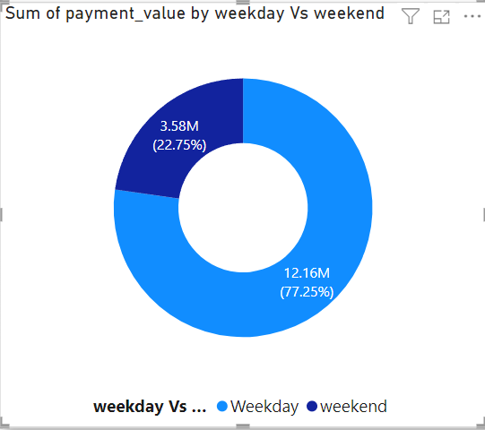
Kpi 1
Here we use donut chart to show the sum of payment value in weekday vs weekend.
Payment transactions is maximum on weekday nearly about 77.25% and on weekend it’s minimum nearly about 22.75%.

Slide 7
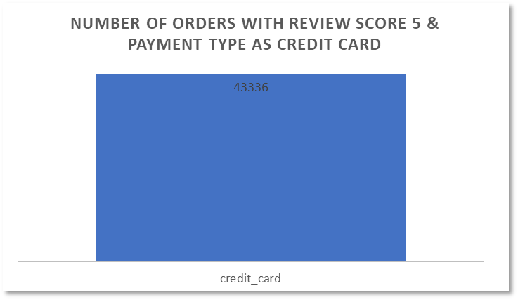
Kpi 2
In this kpi ,there are 43336 numbers of orders with review score 5 and payment transaction was done with help of credit card.

Slide 8
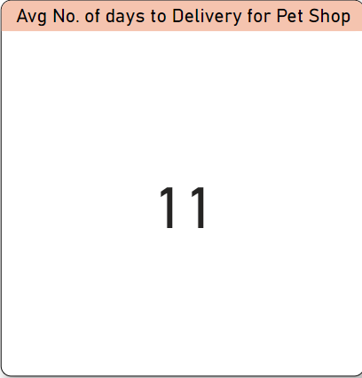
Kpi 3
Here, we find out that average number of days to delivery for pet shop is 11.

Slide 9
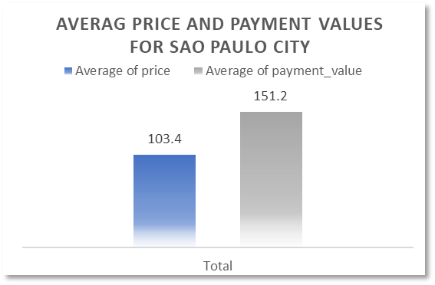
Kpi 4
Here, we use bar chart to show the average of payment value and average of price from Sao Paulo city.
The average of price for sao paulo city is 103.4 where as average of payment_value is 151.2

Slide 10
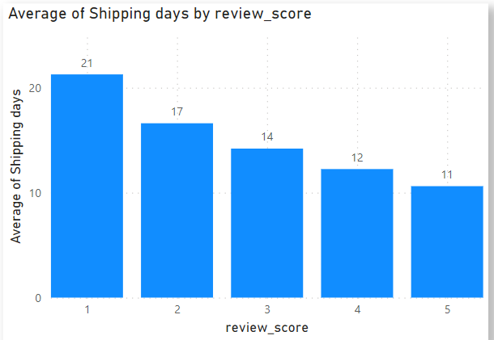
Kpi 5
In this kpi, we use bar chart to show the average of shipping days vs review score.
Here we can see that average number of shipping days are inversely proportional to the review score.

Slide 11
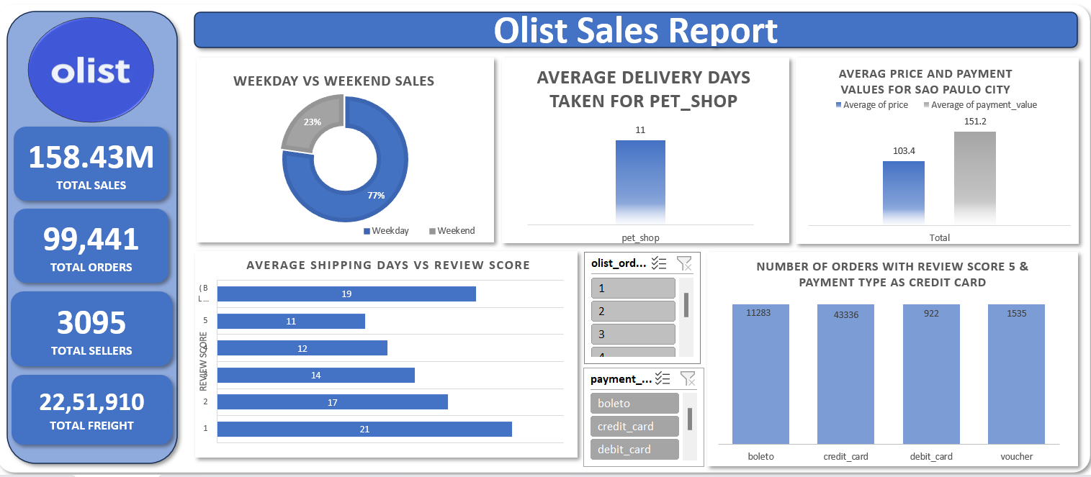
DASHBOARD

Slide 12
SWOT Analysis:
Strength
Weakness
Opportunity
Threat
Wide Reach
Nation wide Strong Market
Brand Reputation
Flexible Mode of Payment
Weekend Sales
Long Term Customer Relationship
Cybersecurity Threats
Competitive Pressure
Customer Retention
International Expansion
Upgrade and Update

Slide 13
SUMMARY :
Visualization of Major KPIs through Excel, Power-BI and Tableau.
SWOT Analysis Study
Overview
- Nation wide strong Customer Base
- International Expansion
-Logistics
- Customer Satisfaction
- Security
- Updated and Upgrade

Slide 14
THANK YOU

